Slide 1
Gesture based motion control
AJITH KEVIN ANAND.K 211616115002
ILAMPARITHI.K 211616115021
VIGNESH CHANDRU 211616115052
VISHAL CHANDRU 211616115057
SUPERVISOR: KEERTHANA.D
(ASSISTANT PROFESSOR)

Slide 2
ABSTRACT
The goal of this project is to train a Neural network algorithm capable of classifying images of different hand gestures, such as a fist, palm, showing the thumb, and others. This particular classification problem can be useful for Gesture Recognition.
By the use of gesture detection, hands free motion of the vehicle is controlled, and this technology is used to automate the vehicle parking system. . It enables the vehicle to use the collision prevention system and guide the vehicle out of the garage. This simulation is done, considering the electrical vehicle.

Slide 3
INTRODUCTION
Over the years, technology has evolved to a greater extent to reduce the human effort and enhance efficiency of the technology, by software updates or innovative product innovations.
Using machine learning module, it is possible to recognize gestures and respond according to the detected gestures.
Automatic car Parking was initially achieved by remote access and later through sensors and by a push of a parking assist button.
Nowadays technology has given us more opportunity to achieve more, with ease by utilization of appropriate hardware with optimized software.

Slide 4
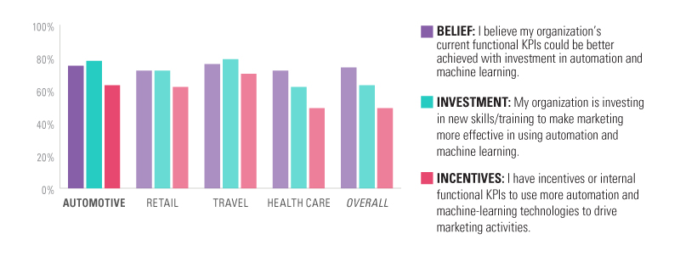
machine leaning in automotive industry
In the automotive industry, machine learning is most often associated with product innovations, such as self-driving cars, parking and lane-change assists, and smart energy systems. Gesture recognition is an advanced technology that uses deep learning or machine learning techniques to identify a person using their hand gestures.
Source: MIT Sloan Management Review

Slide 5
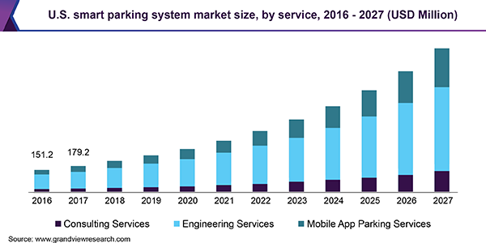
Growth AUTOMATED CAR PARKING SYSTEM
Source: www.grandviewresearch.com

Slide 6
Literature survey
Sl.No | YEAR | AUTHOR | TITLE | INFERENCE
1 | 2007 | Pei Jia; Huosheng H. Hu | Head gesture recognition for hands‐free control of an intelligent wheelchair | It presents a novel hands – free control system for intelligent wheelchairs using head gestures
2 | 2009 | Masafumi Hashimoto; Kazuhiko Takahashi ; Masanari Shimada | Wheelchair control using an EOG- and EMG-based gesture interface | The nonverbal interface to hands-free control of an electric wheelchair is achieved
3 | 2009 | David Sachs ; Steven S. | Mobile devices with motion gesture recognition | Hand gestures are used to control mobile actions

Slide 7
Sl.No. | YEAR | AUTHOR | TITLE | INFERENCE
4 | 2010 | Guy Hoffman; Gil Weinberg | Gesture-based human-robot Jazz improvisation | A novel interactive improvisation system based on gestures is used for musical purposes
5 | 2011 | Jens Lambrecht ; Martin Kleinsorge | Markerless gesture-based motion control and programming of industrial robots | A gesture based control system is used to control industrial robots
6 | 2017 | B Yan, F Weng, L Ren, YC Cheng, Z Shen | Gesture-based information and command entry for motor vehicle | Gestures are used as a method to unlock vehicle doos

Slide 8
Sl.No. | YEAR | AUTHOR | TITLE | INFERENCE
7 | 2017 | J Kumar, X Yang, Q Li, EA Bernal, R Bala | Hand-gesture-based region of interest localization | Hand gestures are used to control vehicular motion
8 | 2019 | P Teotia, A Srivastav, N Varshney, J Kanaujia | Gesture controlled vehicle for military purpose | Hand gestures are used to control small military rovers
9 | 2019 | O Vaidya, K Jadhav, L Ingale | Hand Gesture Based Music Player Control in Vehicle | Hand gestures are used to control the music player in the vehicle

Slide 9
Sl.No. | YEAR | AUTHOR | TITLE | INFERENCE
10 | 2019 | MJ Cheok, Z Omar, MH Jaward | A review of hand gesture and sign language recognition techniques | Hand gestures are developed for multipurpose usage

Slide 10
RESEARCH GAP
From the above literature surveys we can infer that neither smart door lock system nor facial recognition have been incorporated with each other using deep learning
In our project we have incorporated both these technologies together using deep learning and facial recognition techniques.
Using deep learning the accuracy is significantly increased and thus security is enhanced.

Slide 11
CONCEPTUAL DESIGN
MATERIALS:
FABRICATION
Aluminium Sheet (29.5 x 22.3 cm)
Wheel ( Diameter: 7cm, width: 2cm ; Shaft hole: 6mm )
Nut and Bolt

Slide 12
ELECTRICAL COMPONENETS:
DC Motor: | Output RPM: 100 rpm
 | Input Voltage: 6-12 V
 | Stall Current: 500 - 600 mA
 | Shaft length: 2.4 cm
 | Shaft diameter: 6mm with internal hole
 | Motor weight: ~100gms
Arduino Uno R3: | Microcontroller: ATmega328
 | Operating Voltage: 5V
 | Input Voltage (recommended): 7-12V
 | Clock Speed: 16 MHz
 | DC Current per I/O Pin: 40 mA
Power Distribution Board Version 2: | Input voltage: 12v

Slide 13
OTHER COMPONENTS:
CIRCUIT: Arduino UNO R3
Servo motor
Power Distribution Board
Jumper Wires
Battery(12v)
Ultrasonic sensors
SOFTWARE: Python 3.7 IDE
IP Webcam App
Arduino
Windows 10

Slide 14
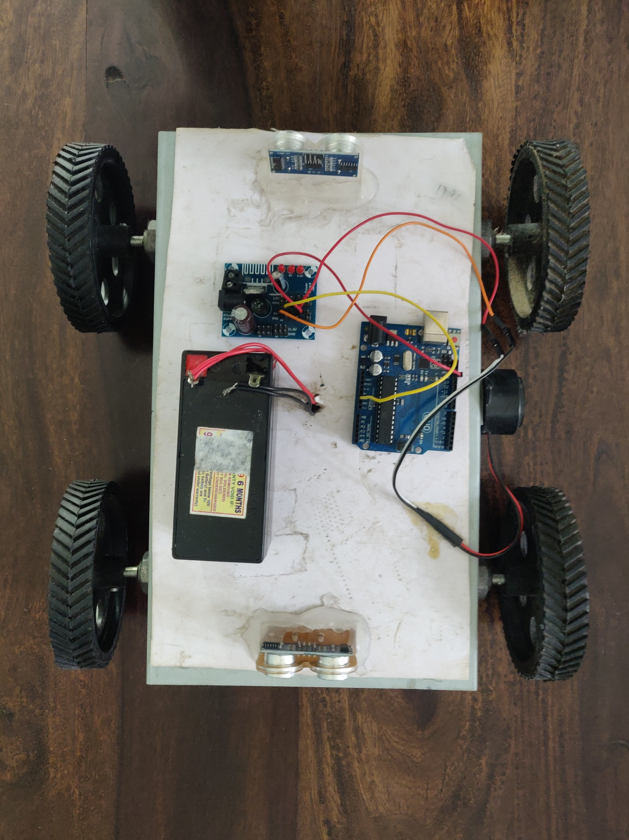
COMPONENTS
ARDUINO UNO R3
WHEEL
POWER DISTRIBUTION BOARD VERSION 2
SIDE COLLISION PREVENTION SENSOR
BATTERY(12V)

Slide 15
Working Mechanism
This robot is a gesture controlled one which can be controlled from anywhere by the help of internet of things aka IOT.
It uses a server from Thingspeak, to send and receive the data from modules to facilitate the gesture based communications.
In this project a camera and a deep learning model is used for collecting data regarding our hand movements.
It detects the gestures. This data is sent to Arduino which processes this data and decides which diection the vehicle should move.

Slide 16
This data is sent to a Bluetooth module, which in turn sends this data to our android mobile which has an app made by us.
The app has been made through MIT app inventor website. This app receives this data and sends this data to thing speak website. Thingspeak.com is a free IOT website which stores this data.
On the receiver side, node mcu WI-FI module receives this data and then drives the motors through motor driving board connected to it.

Slide 17
Methodology
Deep learning
Transmitter
Setting up server
App creation
Receiver

Slide 18
Deep learning…
LOADING DATA
It contains around 100 images with different hands and hand gestures. There is a total of 10 hand gestures of 10 different people presented in the data set. There are 5 female subjects and 5 male subjects.
With that, we have to prepare the images to train the algorithm. We have to load all the images into a file and the label of the file is stored according to the gestures.

Slide 19

TRAINING MODEL
A Convolutional Neural Network (Fig 2.1) is a Deep Learning algorithm which can take in an input image, assign importance (learnable weights and biases) to various aspects/objects in the image and be able to differentiate one from the other. The pre-processing required in a ConvNet is much lower as compared to other classification algorithms. While in primitive methods filters are hand-engineered, with enough training, CNNs have the ability to learn these filters/characteristics.

Slide 20
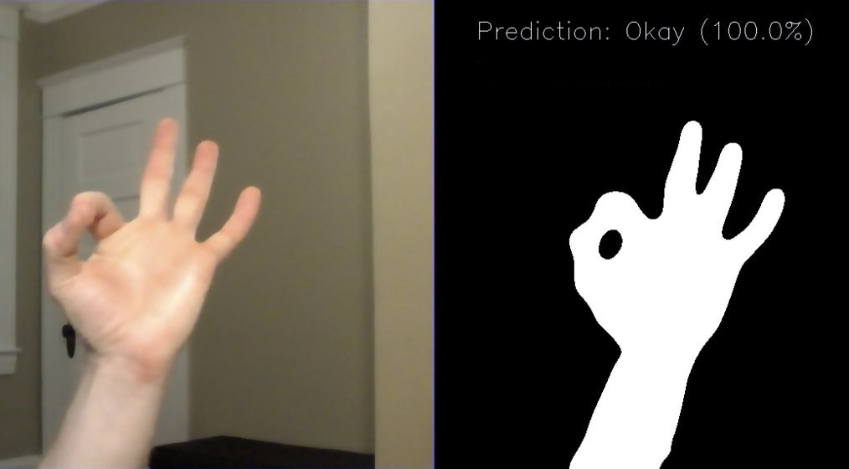
TESTING MODEL
Now that we have the model compiled and trained, we need to check if it’s good. First, we run the model to test the accuracy. Then, we make predictions and plot the images as long with the predicted labels and true labels to check everything. With that, we can see how our algorithm is working.

Slide 21
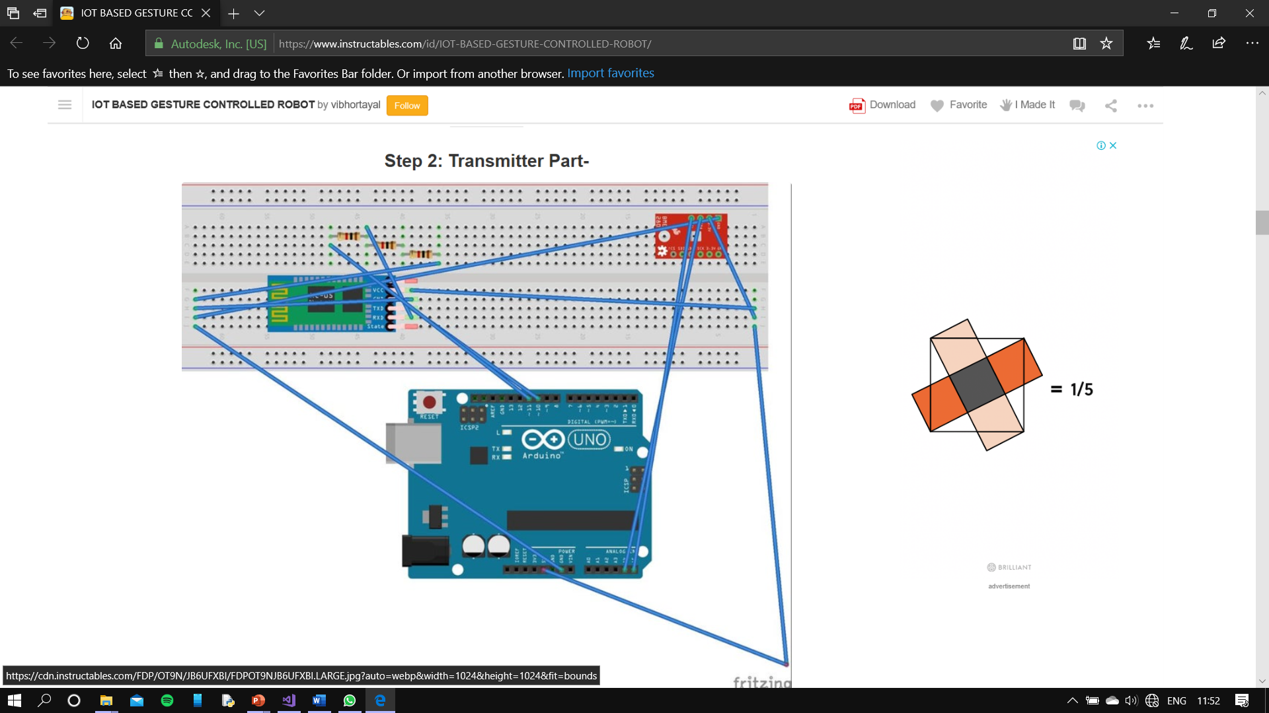
Transmitter….
For the transmitter make the connections as follows-
Take a jumper wire and connect it at one of the end of the breadboard and the other end of the jumper wire to 5V pin of arduino board as shown in the figure.
Take another jumper wire and connect it at another end of the breadboard and the other end of the jumper wire to Gnd pin of the arduino board as shown in the figure.
Take another jumper wire and connect it's one end with the 5V hole of breadboard and other end to VCC pin of MPU6050.

Slide 22
Similarly, with another jumper wire to Gnd of breadboard and other end to Gnd of MPU6050.
Then connect SDA pin of MPU6050 to A4 pin of the Arduino and SCI pin of MPU6050 to A5 pin of the Arduino by the help of jumper wires.
Then take HC-05 Bluetooth module and connect it as follows-
Take a jumper wire and connect it's one end to VCC of breadboard and another end to VCC of the Bluetooth module.
Similarly take a jumper wire and connect it's one end to Gnd of Breadboard and another end to Gnd of Bluetooth module.
Now connect TX pin of Bluetooth module directly to pin D10 of Arduino.

Slide 23
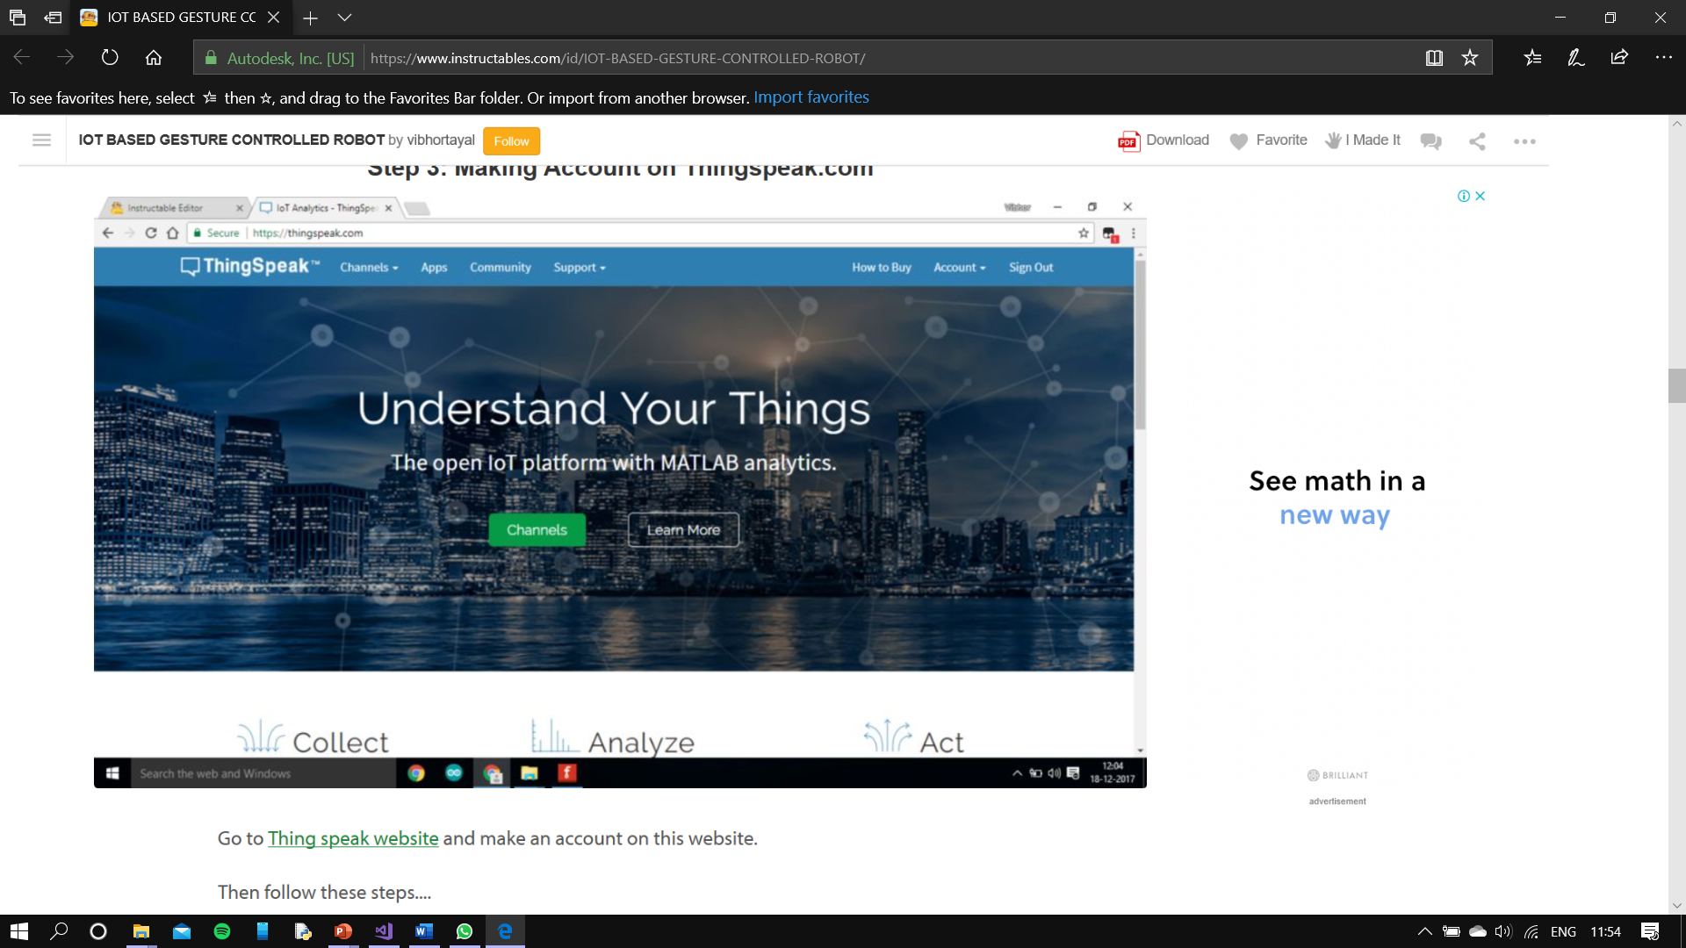
Setting up server…
1. Go to my channels and create a new channel with any name and give any appropriate field name as you like....
2. Click on submit and save the channel.
3. Go to this channel and on API Keys field ,you can see write and read field keys. Copy the URL of the update channel feed on the right side of the screen.
4. Now click on the Apps option on the top of the screen and scroll down and click on the second last option i.e. Talk back option. This is the app we are going to use to feed data to this website.

Slide 24
App creation….
1. Create a new project and name it.
2. On screen 1 , you will see an image of an android phone.
3. First click on Label on left hand side of the screen and drag it to the android screen.
4. Then click on List Picker from the left hand side and drag it on the screen and on the right hand side go on the text option and write connected there. This list will show all the devices waiting to be connected to the android phone.
5. Click on button on the left hand side and then drag on the screen in the text field write disconnected as when we will click on this button then device will be disconnected from mobile.

Slide 25
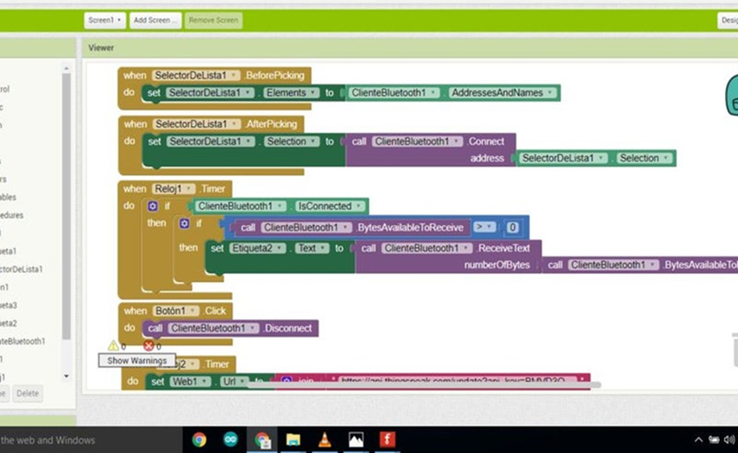
6.Click on the Label on the left hand side and drag it on the screen. Then in the text field on the right side write Data.
7. Click on the Label on the left hand side and drag it on the screen. This is used to display the data received by the app.

Slide 26
Receiver….
1. First connect battery to battery sniper and connect the red wire i.e. the VCC wire to one end of breadboard.
2. Similarly connect the other end of the wire to other end of breadboard.
3. Now take a jumper and connect it to VCC pin of NodeMCU and other end to VCC pin of breadboard.
4. Now take a jumper and connect it to Gnd pin of NodeMCU and other end to Gnd pin of breadboard.
5. Take your motor driving board and connect it on your chassis.
6. Take two jumper wires and connect their one end to VCC of breadboard and another to 9V pins of motor driving board.
7. Take two more jumper wires and connect their one end to Gnd of breadboard and another to Gnd of motor driving board.
8. Connect two wires of left motor to output pins of motor driving board.
9. Similarly connect two wires of right motor to output pins of motor driving board.
10. Connect four input pins on motor driving board to four digital pins of NodeMCU

Slide 27
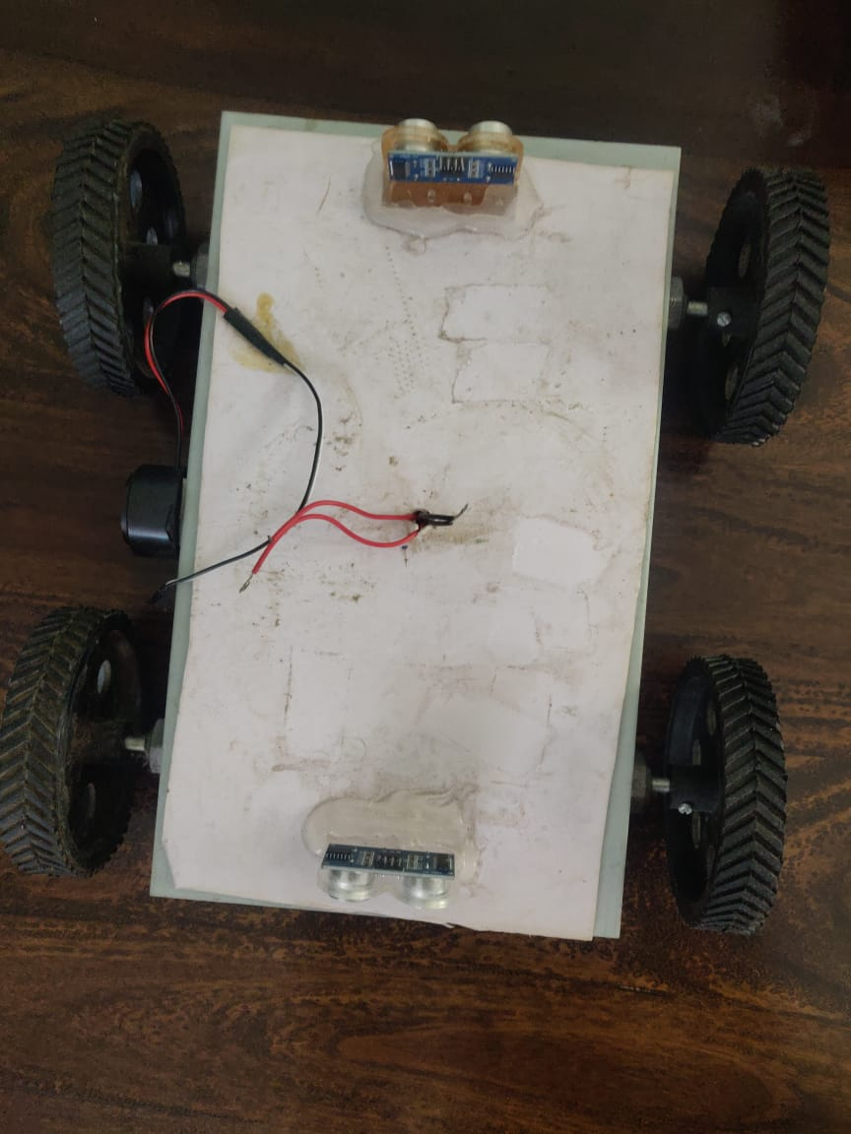
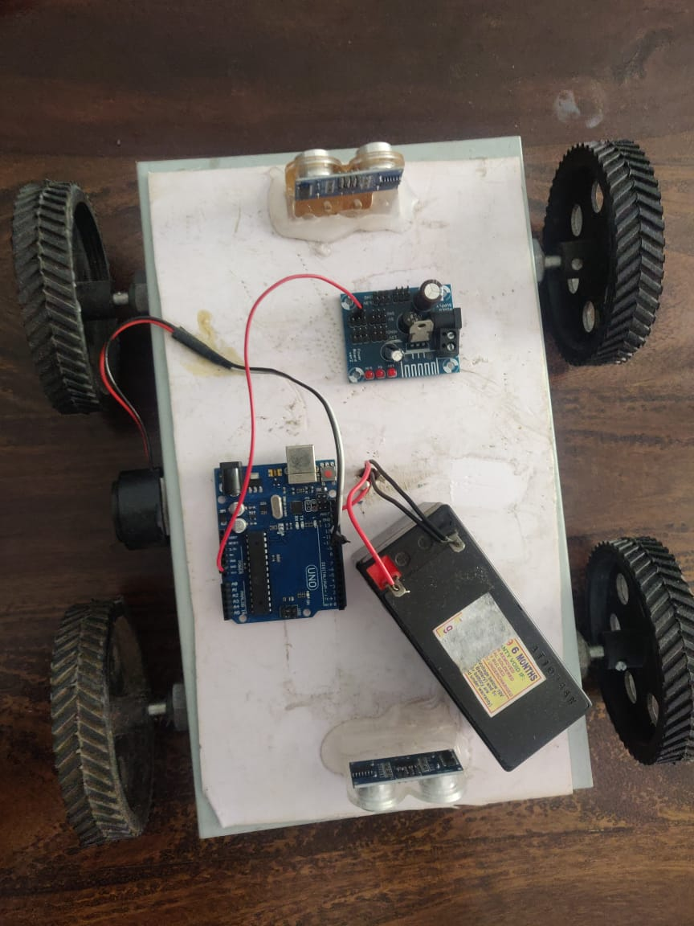
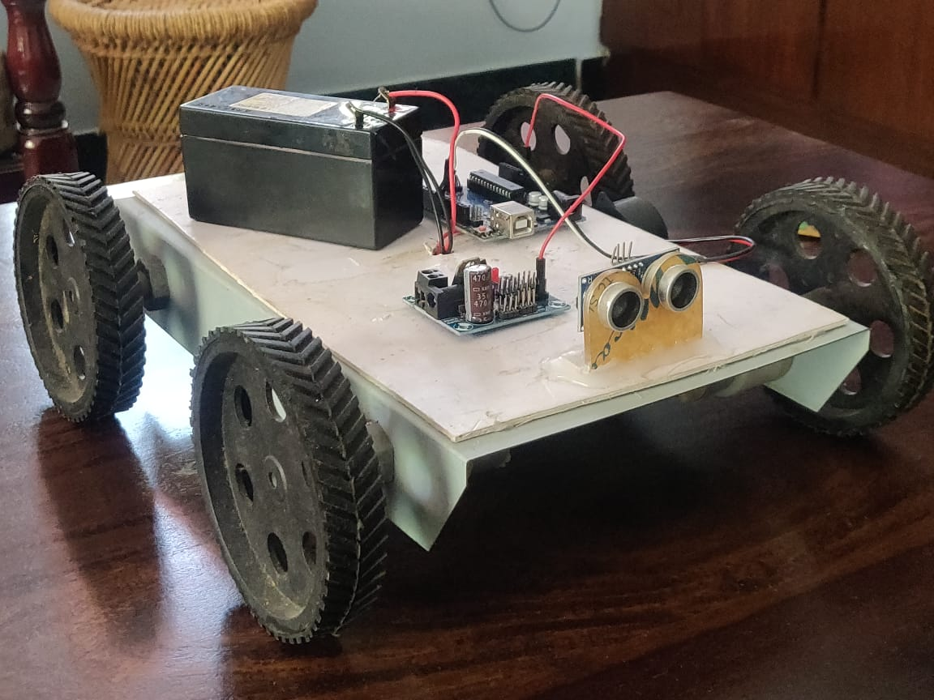
GALLERY

Slide 28
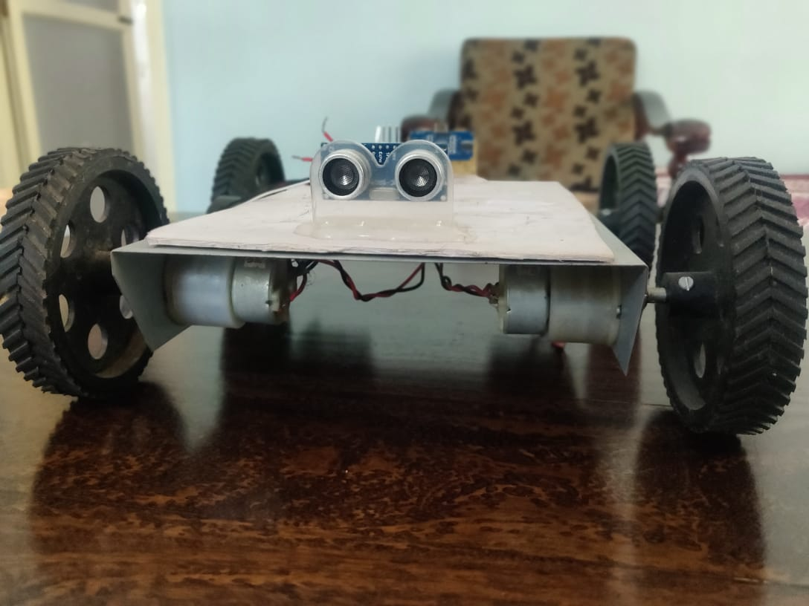

Slide 29
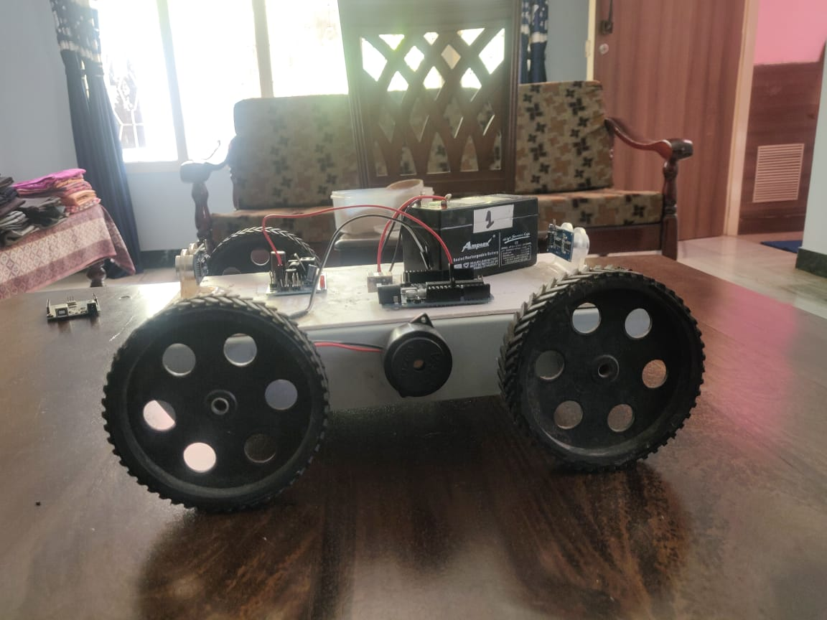
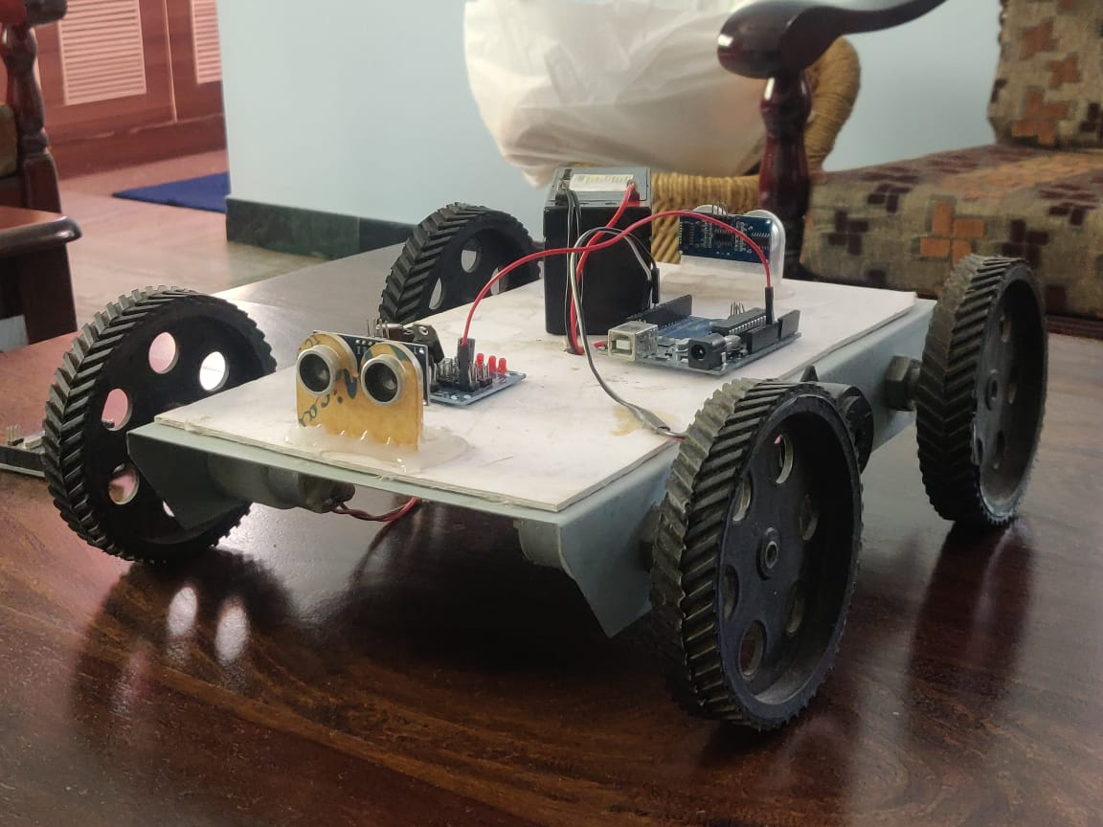

Slide 30
Result
The Prototype of automated car parking system and motion control using gestures was successfully built to achieve easier access to the car, to move in and out of the garage. The idea has been achieved by an obsolete method of using an accelerometer sensor to read the position of the hand and accordingly move the car to the desired position, over the years .
We have considered the more efficient and accessible way of gesture recognition by methods of bleeding edge technology such as image processing and machine learning, and with the help of IOT and app development we were able to receive the data to our phones and other electronic devices as well.

Slide 31
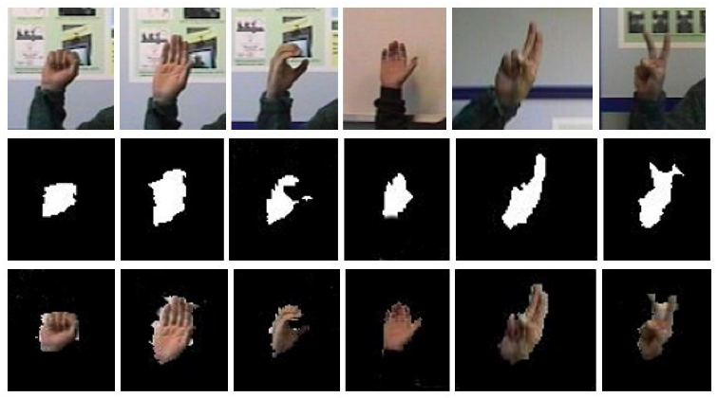
Initially the background is first caught and stored by the algorithm.
Later when any gestures placed in front of the camera, it recognizes the gestures by mapping it with the stored background and differentiating the background, by converting the pixels black and white.

Slide 32
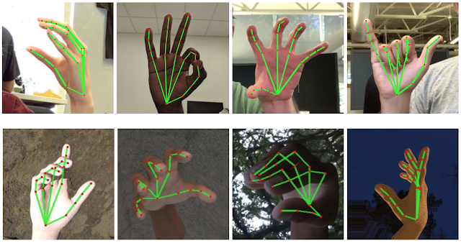
These gestures are compared to the already stored images of gestures and are classified.
These gesture recognition has been successful upto 89% accuracy, and needs more improvement in the coming future.

Slide 33
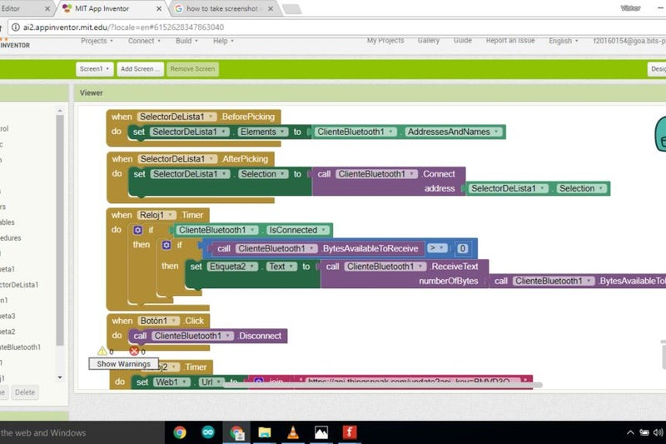
The recognized data is then transferred to the app created, thus it makes the owner to view and control the car accordingly with their mobile. This was achieved by the use of Bluetooth module, which transfers the data to the app.

Slide 34
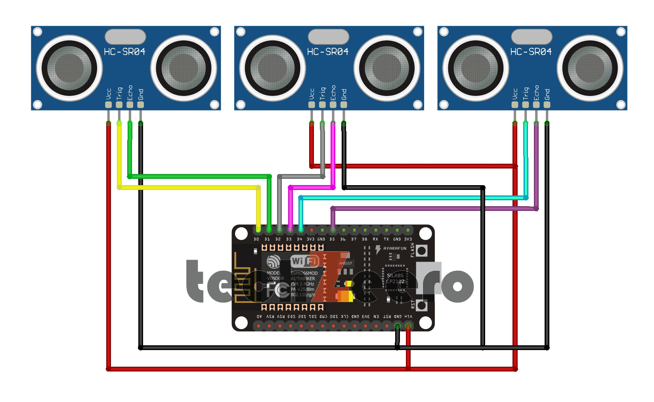
This data is then fetched by the car through Internet Of Things, where a separate server is built for this operation.
The car moves according to the given gesture by obtaining the position, it has to move from the server, by means of the wifi esp module.

Slide 35
CONCLUSION
We have successfully built an gesture controlled automatic car parking which is more robust and efficient way to make a car enter and exit the garage.
This has enhanced the way to communicate to our car and helped to better access the cars automatic parking assist. Obstruction sensors around the car prevents the car from scratches or accidental damages, while moving into the garage. All the communications is achieved by Internet Of Things which has allowed us to have a seamless transmission of data across devices.
Remote access to the car have only limited movements, while hands free control has allowed the car to move with wide degree of motions which is the future of electric cars

Slide 36
REFERENCES
S.Suman, S.Shrivatsa- Motion and system enabling control of different digital devices using gesture or motion control- 2018- Google Patents
J Pirker, M Pojer, A Holzinger, C Gütl- Gesture based interactions in video games using leap motion controller- 2017- International Conference on human
HY Lai- Hand gesture recognition system for controlling electronically controlled devices- 2019- Google Patents
S Song, D Yan, Y Xie – Design of control system based on hand gesture recognition- 2018- IEEE
A Jackowski, M Gebhard – Head motion and head gesture based robot control – 2017- IEEE
A Sarkar, KA Patel, RKG Ram- Gesture control of a drone using a motion controller- 2916- IEEE

Slide 37
G Strutt, J Bjørne, G Birkedal- Gesture control- 2019- Google Patents
W Luchner, J Pennock, E Veit- Gesture and motion based control of user interfaces- 2019- Google Patents
S Surve, A Nair, A Singh, V Krishna – Iot based gesture control gaming-2018- Academia.edu
W Zhi-heng, C Jiang-tao, L Jin-guo – Design of human computer interaction control system based on hand gesture recognition- 2017-IEEE

